Slide 1
Modeling and Solution Strategies of MINLPs as MPCCs for Chemical Process Optimization
L. T. Biegler
Joint work with Alex Dowling,
Ravi Kamath, Ignacio Grossmann
June, 2014
Notes:
Advanced power generation processes are challenged by needs for minimization of CO₂ emissions, higher energy efficiency and integration of superior processing technologies. These challenges also require the development of more effective models and strategies for large-scale process optimization. This study considers optimization tools and formulations for process synthesis, which highlight equation oriented modelling environments, nonsmooth modelling via complementarity conditions and fast optimization algorithms. We especially focus on novel formulations for process synthesis that take advantage of these state of the art optimization algorithms. All of these are formally represented as bi-level nonlinear programming (NLP) problems and include Gibbs reactor models, vapour-liquid equilibrium with vanishing and reappearing phases, and simultaneous heat integration and flowsheet optimization. These applications are demonstrated on the process synthesis of a coal oxycombustion process for clean electric power generation.

Slide 2
Overview
Introduction
Process optimization
Formulation and solution strategies
Bilevel Optimization → MPCC
Phase equilibrium
Heat integration
Process Optimization Case Study
MHEX with phase changes
ASU Synthesis
Conclusions
Notes:
PRES Talk
1. Intro - why and how of optimization
2. Challenges
- legacy codes and rough terrains (vs. EO utopia)
- inherent problem nature:
discrete decisions,
bilevel optimization
nonsmooth features (give examples?)
Can we reformulate and exploit fast optimization for these?
3. Reformulation of MPCCs
- problem structure (multi-level optimization, many inner problems are convex)
- reform with necessary conditions
- rewrite complementarity conditions (MIP/penalty/relax/smooth) as necessary
initialization strategies: ideal--> nonideal, shortcut--> rigorous, add losses, dP ne 0, satisfy conservations laws throughout
4. Implications for Optimal Synthesis of Energy Processes
- examples of nested problems
phase equilibrium (flash and distillation)
phase/chemical equilibrium (Gibbs reactors)
simultaneous heat integration and process optimization
5. Examples of each
- combustor, simple mention here, refer to paper
- phase equil - distillation below min reflux
- heat integration - motivate with TQ target with HRAT given
6. Case Studies
PRICO process - compare with Smith GA result
ASU case study
- ideal --> CEOS
- compartment models --> MESH
- dP = 0 --> dp > 0
superstructure with complements but no integer variables
give results and computational stats.
**********************
Gundersen - subambient processes (with Fu, Aspelund, Marroleja-Correa,‚Ä¶)
- LNG, floating platforms
- ASU, oxycomb.
- H2 lequefaction
- cold box for ethylene processes
Process Integration, since Hohmann (1971) - now with heat, water, hydrogen
less important for subambient (because of pressure and power),
- compressors and expanders play most important role
(power is pure exergy!, entropy production <==> energy losses)
- stream and utilities may change definition
- hot and cold change their sense over the process
(LB: need cooling/hearing for exchangers)
- importance of compression, irreversibilities --> exergy losses
in mixing, throttling, dT > 0, dP > 0 (friction)
(LB: minimize work directly, use this to exploit synergies of optimization - need more detailed models and high performance algorithms)
UA is a better spec than dT_min
Examples:
patented Fu/Gundersen example - single column ASU, designed with McCabe-Thiele and grand composite curves
Wechsung, Aspelund, AIChE J - MINLP
compress above pinch, expand below pinch
def'n of exergy efficieny = Energy_sinks/Energy_sources
cold streams - exergy source
hot streams - exergy sink
Carnot factor vs. Q curves (similar to TQ) but nonlinear
generated by simulation
exergy not easily seen from curves
(LB: need to do detailed numerics, how to embed this into NLP?)
used Ideal assumption at reformulated this to corresponding
heat/exergy cascades (cannot handle CEOS), this allows carnot factor
to be replaced by T^E and leads to linear pinch curves
--> used curves to rediscover Brayton cycle
**********************
Smith -
graphical method vs. Mathematical Programming
MP: cannot get conceptual insights
(LB: need to see in higher dimensions, NLP sensitivity, also insights
are required for proper opt. model formulation)
e.g., model steam superheat, currently pinch curves are piecewise
constants and more realistic targets are required
(LB: NLP can do this, divide ht. exchangers and locate phases, in DG
formulation pinch curves (slopes and temperatures) move around)
Exploit terrain -
Boiler Feed Water (BFW) - replace piecewise constants with slopes
Flash to lower pressures, add recycles and desuperheat
(leads to tighter integration)
- cogeneration, modeling of restricted matches, look at individual
source/sink profiles
- i.e., put more realism into steam utility systems
(LB: all of these can be incorporated into optimization models)

Slide 3
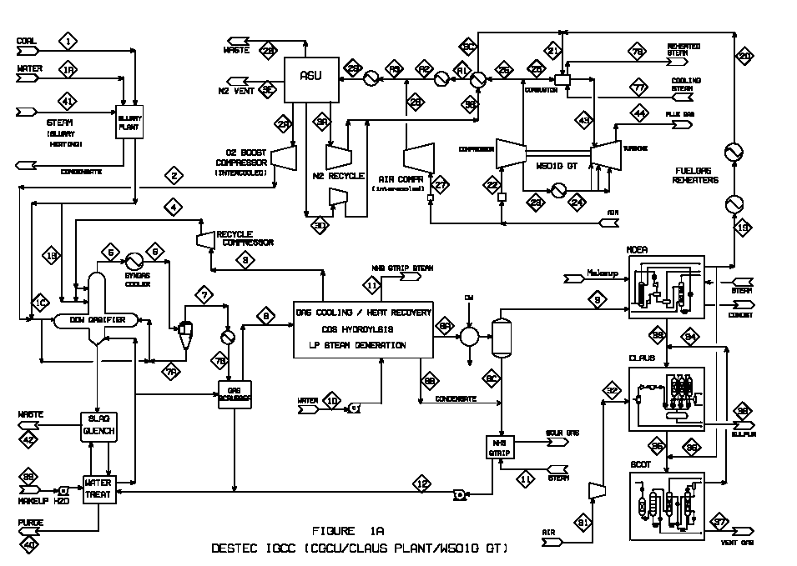
Equation-Oriented Process Optimization Multi-Model Nonconvex NLPs
Conservation
Laws
Performance
Equations
Constitutive
Equations
Component
Properties
Physics-based Initializations
Conservation Laws: Often linear, always satisfied
Equil. Stage Models: Shortcut → MESH
Friction losses, ΔP: Assume none → add later
Physical properties: Ideal → Nonideal
Notes:
Not a push-button strategy! Some user involvement and insight is needed.
Since process optimization problems are nonconvex,
Avoid singularities and ill-conditioning
Physics-based initialization is needed to solve NLP
All of these help initialize NLPs and come up with robust solution strategies

Slide 4
Process Optimization Environments and NLP Solvers
Open
First & Second Derivatives, Sparse Structure
NLP Barrier
Compute
Efficiency
Exact First Derivatives
rSQP
Finite Differences
SQP
Black Box
DFO
Closed
10⁰
10²
10⁴
10⁶
Variables/Constraints
Notes:
Rely less on off-the-shelf codes in order to exploit structure,
Open structure enables MINLP and Global algorithms as well
Go through levels in detail

Slide 5
Bi-level Process Optimization Problems: an Alternative to (some) MINLPs
Formulation Guidelines
Attempt to define regular, convex inner minimization problem (optimistic bilevel problems, Dempe, 2002)
Require connected feasible regions for inner problem variables (no exclusive ORs!)

Slide 6
Solving Bi-level Optimization Problems
Notes:
Determine active set of inequalities, but
Complementarities lead to a singular system
How to deal with these? Reformulate bilevel problem

Slide 7
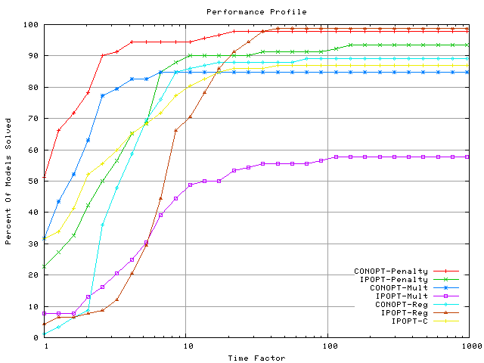
MPCC Solver Comparison (Baumrucker, Renfro, B., 2008)
MPECLib Problem Test Set (Dirkse, 2006)
Results favor active set solvers (e.g., CONOPT) with l₁ penalty formulation
Generally observed with MPCCs in process optimization

Slide 8
Bi-level Process Optimization Models
Min Overall Objective
s.t. Conservation Laws
Performance Equations
Constitutive Equations
Process/Product Specifications
Min Overall Objective
s.t. Conservation Laws
Performance Equations
Constitutive Equations
Phase Equilibrium
Chemical Equilibrium
Heat Integration
Process/Product Specifications
Minimize Gibbs Free Energy
(Vapor Liquid Equilibrium)
Minimize Gibbs Free Energy
(Reactor Model)
Minimize Utilities
Through Heat Integration
Notes:
Another Source of singularity and nonsmoothness occurs when we expose nested minimization problems
These can have switches due to active set changes.

Slide 9
Bilevel Optimization: Simultaneous Process Optimization & Heat Integration (Duran, Grossmann, 1986)
Process
Optimization
Heat
Integration
Process optimization and heat integration tightly coupled
Allows production, power, capital to be properly considered
Data for pinch curves adapted by optimization
T
Q_{s}
Q_{s}
Q_{w}
Q_{w}
Q

Slide 10
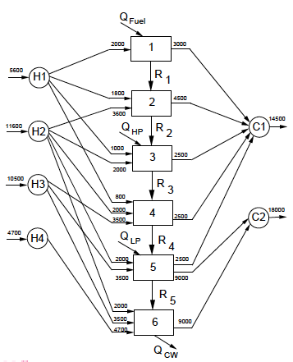
Simultaneous Process Optimization & Heat Integration
Flowsheet objective, process model and constraints
LP Transshipment Model
Stream temperatures as pinch candidates
Energy balance over each temperature interval
Form energy cascade with nonnegative heat flows
→ Models pinch curves
Notes:
Mention Chen talk on power distribution

Slide 11
Bilevel Reformulation: Simultaneous Process Optimization & Heat Integration
Flowsheet objective, process model and constraints
Replace with smoothed max(ξ, 0) functions
Further improved at points where ξ = 0.
(Unroll summations)

Slide 12
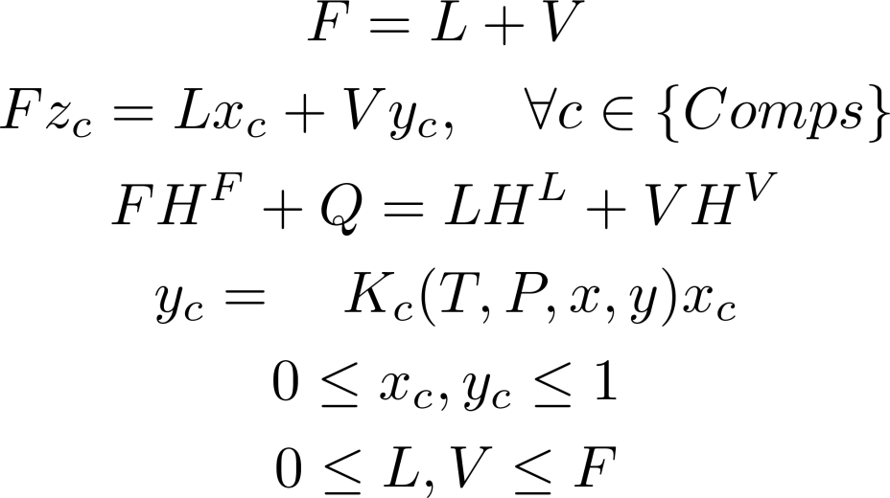
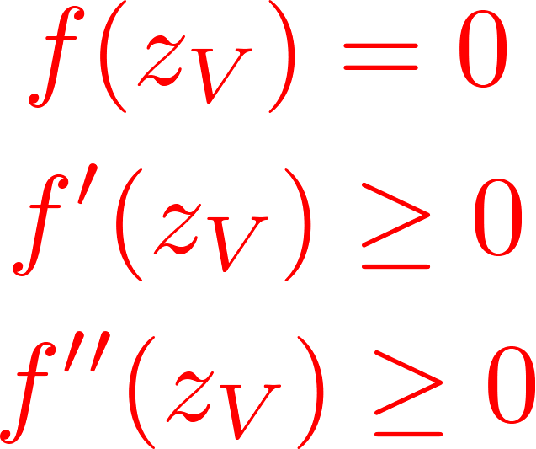
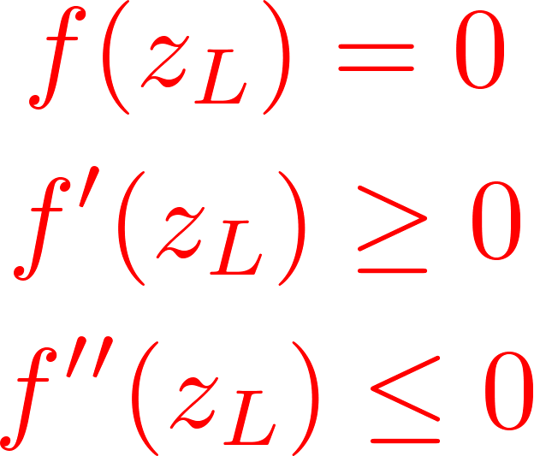
Bilevel Optimization: Phase Equilibrium (Kamath, Grossmann, B., 2011)
Z
Z

Slide 13
Simultaneous Heat Integration and Optimization MHEX for LNG Liquefaction
NG
Precooling
Sea water
-50°C
Liquefaction
Sea water
-80°C
Subcooling
Sea water
-160°C
LNG

Slide 14
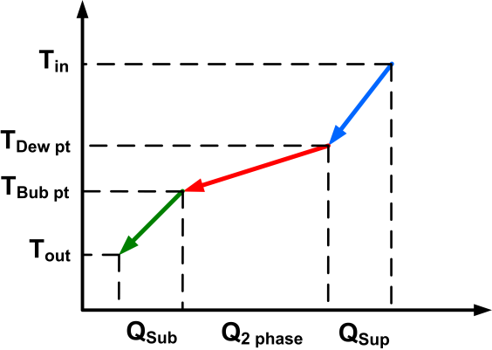
Dealing with phase changes in MHEX
No hot/cold utilities needed
Some streams can change phase during heat transfer (difficulty in enthalpy calculation, FCp is not constant
Phase not known a priori – model with complementarity
Integrated model for optimization and heat integration
Process Constraints
Heat Integration Constraints

Slide 15
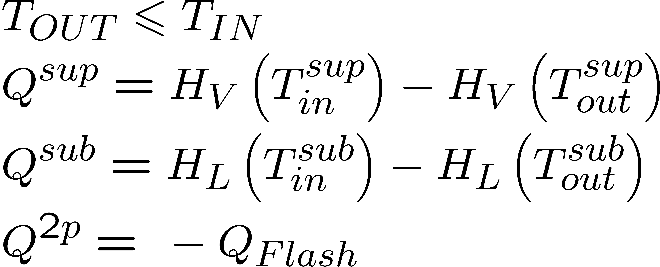
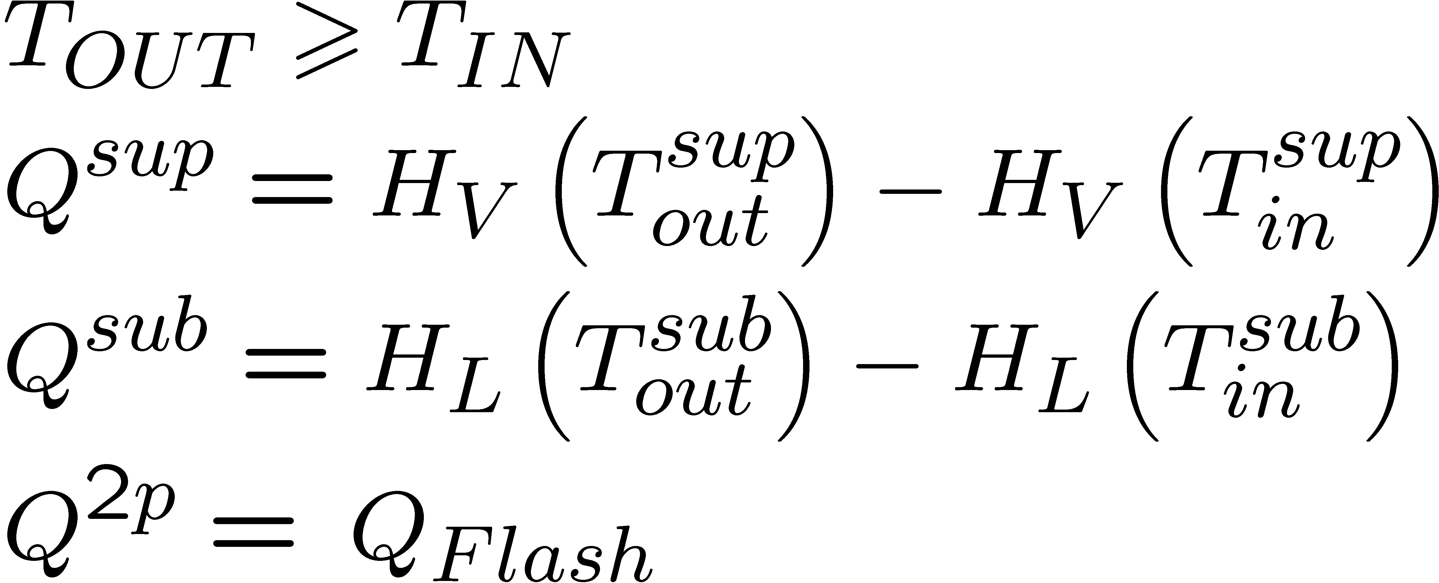
Disjunctions for phase detection
For both hot and cold streams
a) Phase detection for inlet stream
For hot streams
b) Phase detection for outlet stream
For cold streams
c) Equations for Flash calculation for 2-phase region

Slide 16
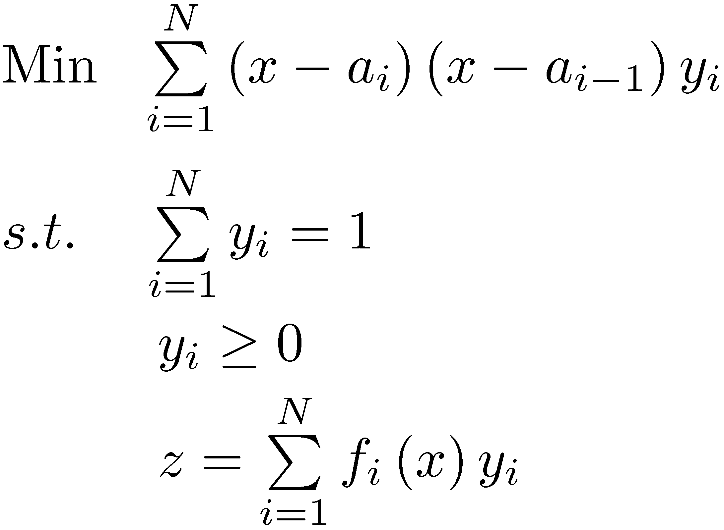
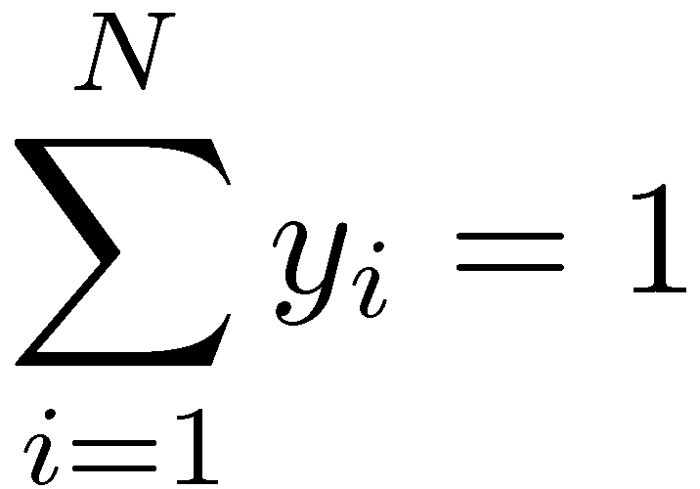
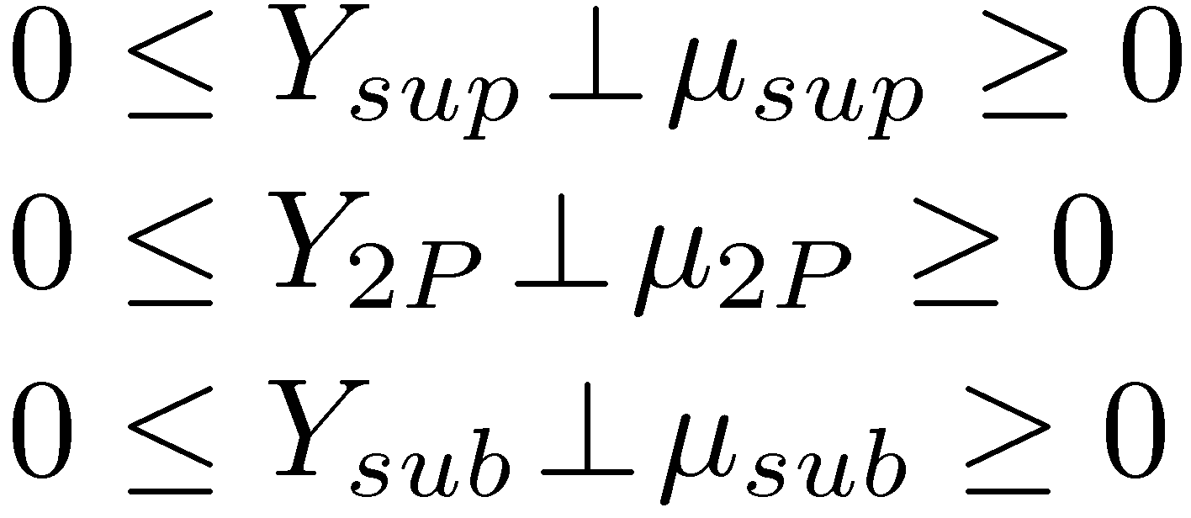
Complementarity Reformulation of Disjunctions (No binary variables)
Pick correct function value in piecewise-smooth domains (e.g. physical property models)
Inner Minimization (LP)
Optimality (KKT) conditions
Raghunathan, B. (2004)
Complementarity constraints
Inner Minimization for our problem
Optimality (KKT) conditions
Complementarity constraints
Notes:
So is all of this math reformulation worth it? Where is the payoff?

Slide 17
Poly Refrigerant Integrated Cycle Operations (PRICO) process – minimize compression
Del Nogal, Kim, Perry, Smith (2008)
DFO (GA) solver with discrete decisions
Variables: 7, Computation: 410 CPU min
For ΔT_{min} = 1.2°C, Power = 24.53 MW
For ΔT_{min} = 5°C, Power = 33.49 MW
Kamath, Grossmann, B. (2011):
EO strategy for heat integration
Variables: 3366, Computation: 2 CPU min
For ΔT_{min} = 1.2°C, Power = 21.51 MW
For ΔT_{min} = 5°C, Power = 28.63 MW
12-15% less power

Slide 18
Distillation: Complementarity Formulation (Raghunathan, B, 2002)
Consists of Mass, Equilibrium, Summation and Heat (MESH) equations
Continuous Variable Optimization
number of trays
feed location
reflux ratio
When phases disappear, MESH fails.
Reformulate phase minimization,
embed complementarity
Model dry trays, Vaporless trays
Initialization with Shortcut models based on Kremser Equations (Kamath, Grossmann, B., 2010)
Notes:
failure to solve distillation problems and to do optimization
thermodynamic properties derived from molecular properties and Maxwell relations
K values result from (unconstrained) Gibbs minimization
mention complementarity that arises from Gibbs minimization

Slide 19
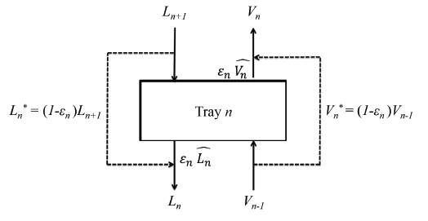
Bypass Trays: Building Block based on Phase Equilibrium (MPCC)
Dummy streams equilibrium streams based on
MPCC for phase equilibrium →
Bypass usually leads to binary solution for ε.
Mixing discouraged in optimization (energy inefficient)
Fractional ε is physically realizable.
#Trays = Σn ε

Slide 20
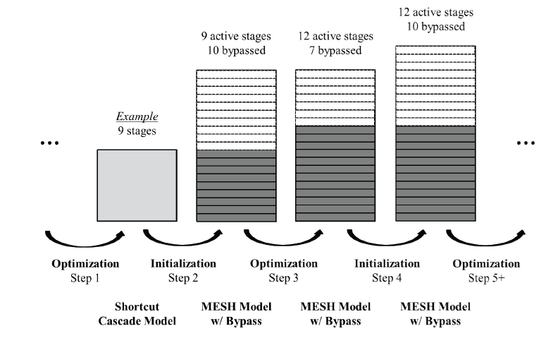
MPCC sequence with Distillation Models

Slide 21
Equation-Oriented Case Study: Air Separation Units
Boiling pts (1 atm.)
Oxygen: 90 K
Argon: 87.5 K
Nitrogen: 77.4 K
Feedstock (air) is free: dominant cost is compression energy
Multicomponent distillation with tight heat integration
Nonideal Phase Equilibrium: Cubic Equations of State
Phase conditions not known a priori

Slide 22
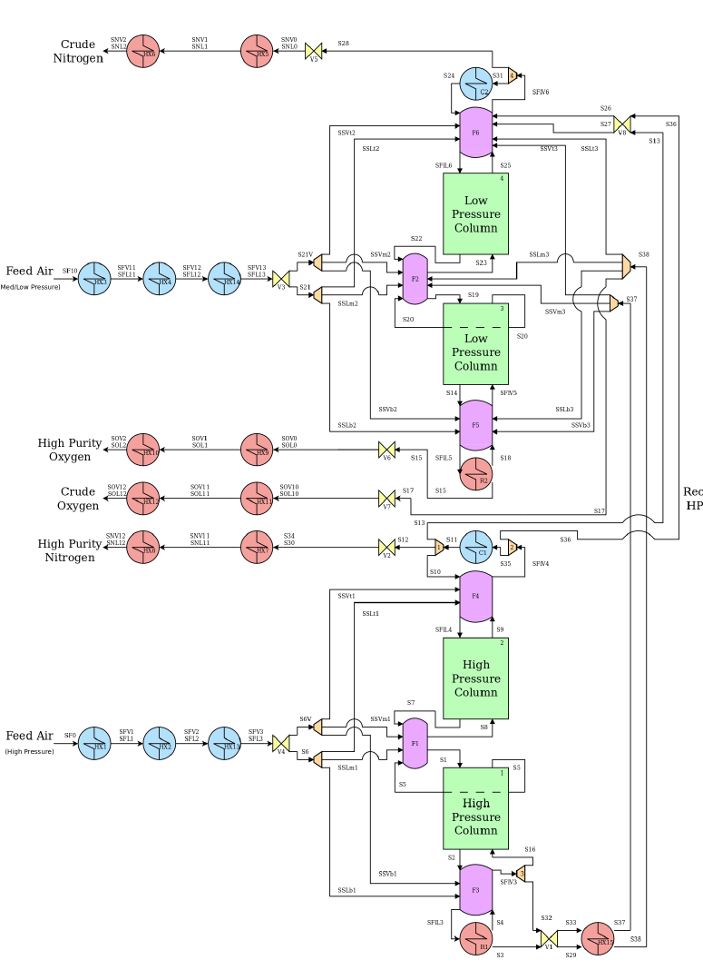
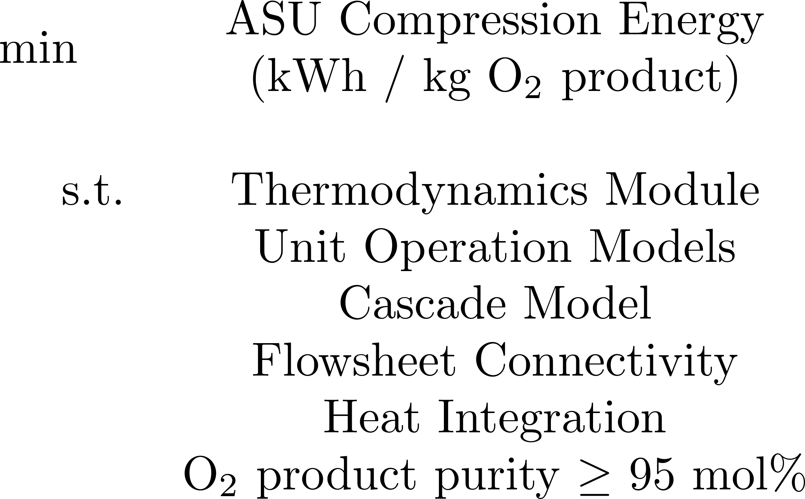
ASU NLP Superstructure

Slide 23
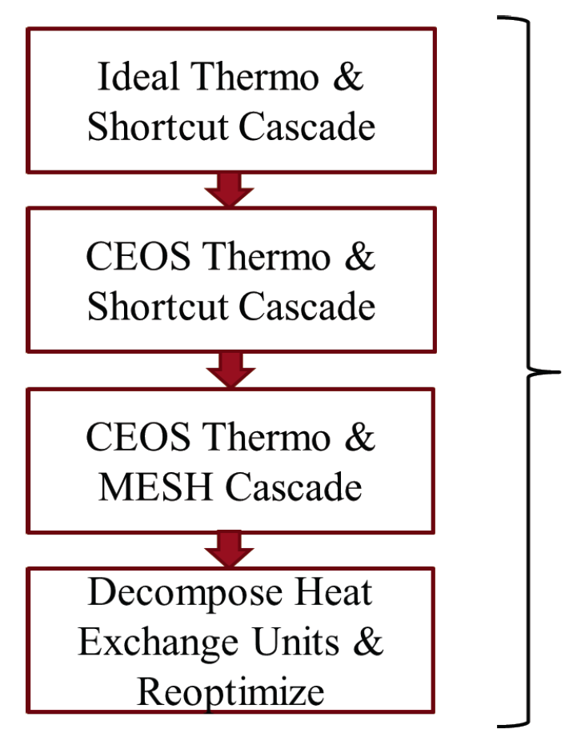
Overall Optimization Strategy
Physics-based initialization, feasible, “near optimal” solutions
Simpler thermodynamics
Easier distillation models
Captures complementarities (phases, #trays) more accurately
Ensures robust, efficient sequence of NLPs to complete model
Multi-start strategy to promote best NLP solutions.
Formulation strategies to avoid degenerate constraints and redundant structures

Slide 24
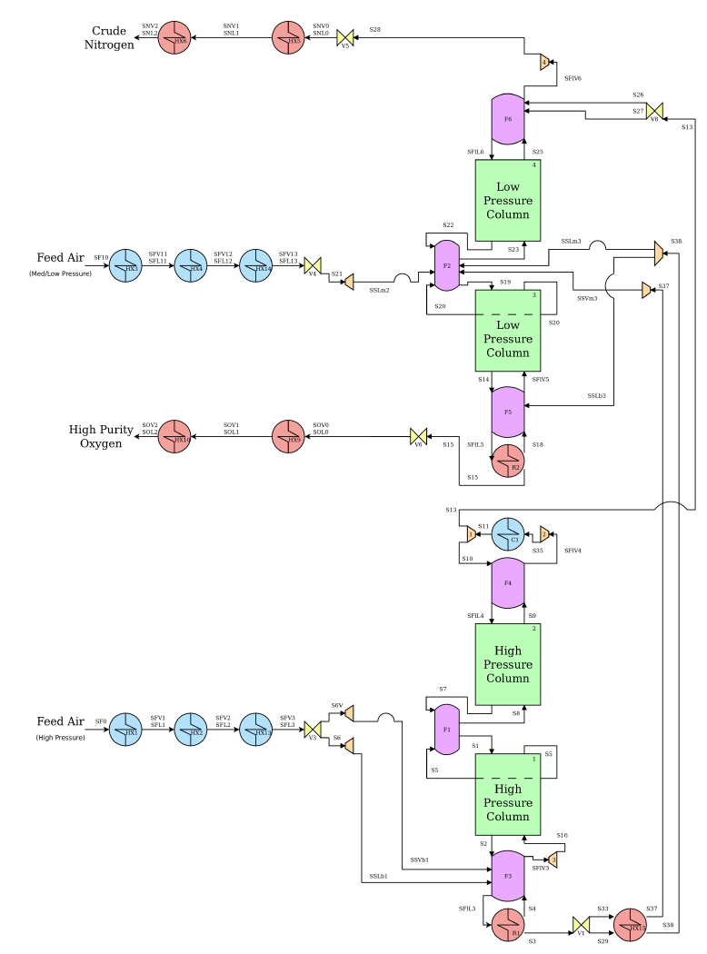
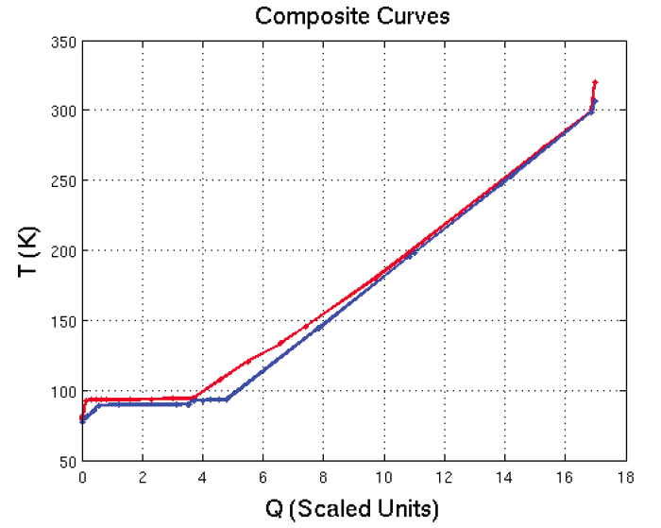
ASU Optimization ΔT_{min} = 1.5 K, 95% O2 purity
LP Column
8% feed air
21 stages,1 bar
98% O2 recovery
Balanced Reboiler/Condenser
No heating and cooling, only power
Typical NLP: 15534 variables, 261 degrees of freedom
NLP sequence ➔ 15 CPU min (CONOPT/ GAMS)
0.196 kWh/kg (86% comp efficiency)
HP Column
92% feed air
10 stages, 3.5 bar
98.4% pure N₂ stream

Slide 25
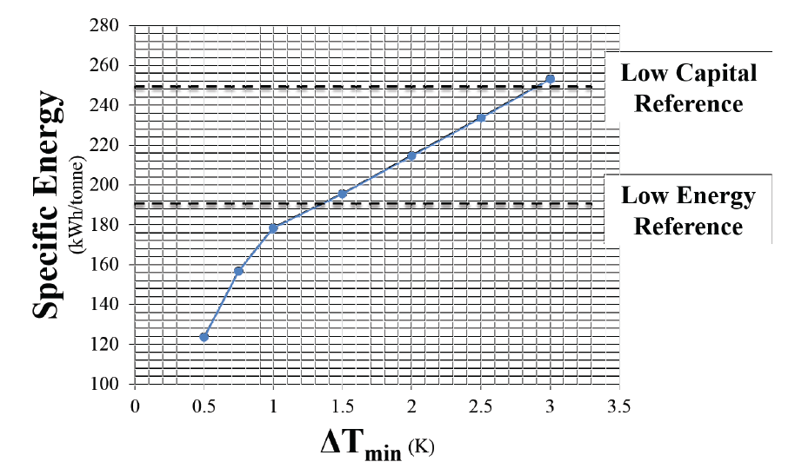
NLP Results wrt ΔT_{min} Comparison with Air Liquide Case Studies

Slide 26
Conclusions
Equation Oriented Process Optimization
Fast Newton-based NLP solvers
Robust formulations and initializations
Exploit bilevel problems as MPCCs
Simultaneous heat integration and optimization
Phase (and chemical) equilibrium
Optimal synthesis of distillation sequences
Process optimization applications
LNG cycles (MHEX, phase changes)
Heat integrated separation (ASUs)
Integrated flowsheet optimization

