Slide 1
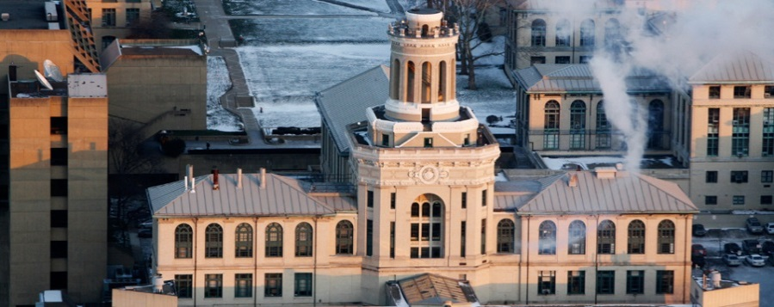

Integration of Different Models in the Optimal Design of Chemical Processes
José A. Caballero
(I. Grossmann, M.A. Navarro, R. Ruiz)
Institute of Chemical Process Engineering
University of Alicante.
SPAIN
Pittsburgh, 1-5 June, 2014

Slide 2
MOTIVATION:
MODELING SYSTEMS ( GAMS, AMPL, AIMMS and similar modeling tools):
Equation based environment
Indexation capacity
Automatic Differentiation: first and second order derivative information very accurate and hidden to the user, and obtained only when needed.
Automatic connection to different solvers without change the model formulation. Large number of different solvers available.
Different models types LP, NLP, MILP, MINLP.

Slide 3
MOTIVATION:
MODELING SYSTEMS ( GAMS, AMPL. AIMMS and similar modeling tools):
Usually not available:
Equipment Libraries Databases
Component Property Databases
Property estimation
There are no difference between equations. Complete system is represented and solved by a set of equations without taking into account where they come from.
In general, no specific initialization methods.

Slide 4
Modular Process Simulators:
Numerical methods specially developed for each process unit. Including Flash calculation in all streams.
Initialization methods specifically design for each unit.
Large Equipment Libraries Databases, Component Property Databases available.
Property estimation methods included
Very robust and reliable
Rigid Input-Output structure: Lack of flexibility. Convergence of recycles based on fixed points or quasi-Newton methods
Most sequential modular simulators include parametric optimization capabilities. (Lang & Biegler, 1987; Alkaya et al, 2000) but not with integer variables

Slide 5
Even though there are “Chemical Process Oriented” Modeling systems
“No matter how large the system you can solve is, there will always be someone who wants to solve larger and more complex problems” (A. Westerberg ~1998)
Objective:
Develop or adapt algorithms that are able of taking advantage of modular process simulators (specially tailored numerical methods, reliability, and robustness) and can use integer and continuous variables.
Hybrid algorithms that combine implicit models and explicit equations

Slide 6
GDP with implicit constraints
Objective Function
Implicit constraints common to all the alternatives
Explicit constraints common to all the alternatives
Implicit constraints depending on the boolen Y_{ij}
Explicit constraints depending on the boolen Y_{ij}
Logical relationships

Slide 7
GDP with implicit constraints
x_{I} Independent variables: Specifications or degrees of freedom in the modular process simulator (or any other third party program). The user has a complete control over these variables.
x_{D} Dependent variables. They can only be read. Their value depend on the x_{I} variables.
u variables that must be fixed. The user has only an indirect control of these variables (i.e. trays in a column).

Slide 8
GDP: Solution alternatives
GDP
Logic Based
Methods
MINLP
Reformulation
Key: Relaxation
Brand & Bound
Decomposition
Convex Hull
Big-M reformulation
( Lee & Grossmann, 2000 )
Outer Approximation and
G. Benders Decomposition
(Turkay & Grossmann, 1997)
Logic LP-NLP-BB
Modeling and Decomposition
( Kocis & Grossmann, 1989)
Cutting Plane
(Sawaya & Grossmann)
Outer Approximation (Duran & Grossmann, 1986; Kocis & Grossmann ,1987; Viswanatan & Grossmann, 1990 ; Fletcher & Leyffer, 1994)
G. Benders Decomposition (Geofrion, 1972)
LP-NLP-BB (Quesada & Grossmann, 1992; Bonami et al, 2008)
Branch & Bound (Gupta & Ravindran, 1985; Fletcher and Leyffer, 1999)
Extended Cutting Planes (Westerlund and Pettersson, 1992)

Slide 9
Depending on where the implicit equations are, and on the control that the user has over those implicit equations the treatment could be different.
There are no implicit equations inside the disjunctions:
i.e. there are no logical decisions affecting the topology of the flowsheet.
discontinuous cost functions for a fixed topology
decisions over the equipment or the operation that does not affect the process simulator
2. There are implicit equations inside the disjunctions
a. Third party programs (functions or modules) over which the user has a complete
control. Numerical problems can be anticipated and explicitly solved.
b. Decisions affecting the topology of the flowsheet. The user only has control on the
input variables and specifications . Require special treatment: i.e. zero input flows
could prevent convergence.
3. Decisions affecting parameters inside the units. i.e. trays in a column. They must be considered case to case and special algorithms must be developed (If possible).
(i.e. Design of Distillation Columns using Process Simulator (Caballero & Grossmann, 2005)

Slide 10
ADAPTED ALGORITHMS:
Branch and Bound (Gupta & Ravindran,1985; Lee & Grossmann,2000)
Solve series of NLP problems in a tree search (no Master needed)
Outer Approximation –MINLP reformulation- (Duran and Grossmann, 1986)
Logic Based Outer Approximation (Turkay & Grossmann, 1996)
Modeling and Decomposition (Kocis & Grossmann, 1989)
LP-NLP Based Branch and Bound (Quesada and Grossmann, 1992)
Logic LP-NLP Based Branch and Bound
Iterate between NLPs and Master (MILP) problems.
In Outer Approximation the Master is solved to optimality in each major iteration.
In LP-NLP based branch and bound the an NLP problem is solved when an Integer solution is found in the tree search of Master problems, all open nodes in the Master are then updated.

Slide 12
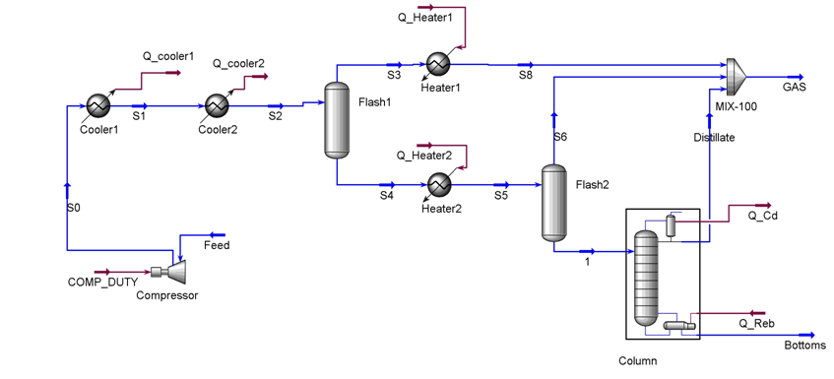
Example 2. Fixed Topology
Natural Gas Plant (Adapted from Seider et al 1999)
At least 4900 kmol/h C4 and lighter. Combined mol frac.>0.995, T>20ºC
5000 kmol/h
P = 1000 kPa
T = 20ºC
105.5 kmol/h N2
4138 kmol/h Methane
435.5 kmol/h Ethane
205.5 kmol/h Propane
70.5 kmol/h n-Butane
28.5 kmol/h n-Pentane
16.5 kmol/h n-Hexane

Slide 13
AVAILABLE UTILITIES
Cooling Tin (ºC) Tout (ºC) ΔTmin (ºC) U (W/m2 ºC) Cost ($/kW-year)
Air 30 35 10 100 0
Water 20 25 10 800 6.7
Cold Water 8 15 5 800 15
R1 -25 -24 3 300 86.3
R2 -40 -39 3 300 106.1
R3 -65 -64 3 300 185.3
Heating
Hot Water 80 60 10 800 15
Vapor LP 125 124 10 1600 59.9
Vapor MP 175 174 10 1600 69.4
Vapor HP 250 249 10 1600 78.8
Other
Electricity 480
Fuel 115.2

Slide 14
Calculated as implicit equations using MATLAB functions.

Slide 17
Optimal solution = 117.05 10³ $/year
Initial relaxed solution = 102.7 10³ (Mixed Big M-convex hull reformulation) ( GAP 12%)
LP-NLP BB: 23 LP nodes (Cplex); 2 NLP sub-problems (snopt7); CPU time = 300.1 s.
OA : 4 Major iterations; 3 NLP sub-problems; CPU time = 708 s.
38 explicit nonlinear constraints; 5 linear constrains;
16 binary variables; 19 external variables (7 specifications in flowsheet);
40 implicit blocks of equations (cost, sizing, correlations) + Hysys flowsheet.
Hot Water 1819 kW
R1 1741 kW
21.0ºC
Cold Water
2322 kW
4973 kmol/h
20.02ºC
15ºC
45.6 m²
-10.7ºC
65.35 kW
156.4 m²
235.9 m²
D = 2.1 m
H = 6.3 m
28.9ºC
15 bar
53.7ºC
R3
231.5 kW
5000 kmol/h
P = 1000 kPa
T = 20ºC
D = 0.67 m
H = 1.98 m
1842 kW
D = 0.21 m
H = 7. 3 m
Packed
88 kW
Combustion Engine
Vapor MP

Slide 18
Example of Superstructure
Synthesis of Methanol
(Adapted from Kocis and Grossmann)
Compressor
Purge
Multi-stage compression with intermediate cooling
Compressor
Cooler
Feed 1
R1
Heater
Reactor 1
Valve
Cooler
Flash
Feed 2
Multi-stage compression with intermediate cooling
R2
Cooler
Reactor 2

Slide 19
Example of Superstructure
Synthesis of Methanol
(Adapted from Kocis and Grossmann)
Compressor
Purge
Compressor
Heater
Valve
Cooler
Flash
Feed 2
R2
Reactor 2

Slide 20
Variable Topology (in the process simulator):
It was formulated as a GDP problem
with two terms disjunctions.
The process simulator is called even for non existing units
Different behavior when x_{in} = 0
The behavior depends on the process simulator or even the unit operation
Requires ‘tricky’ model formulations
The rest of the equations that depend on x_{out}/z_{out} must be written in terms of z_{out}
Usually not good relaxation

Slide 21
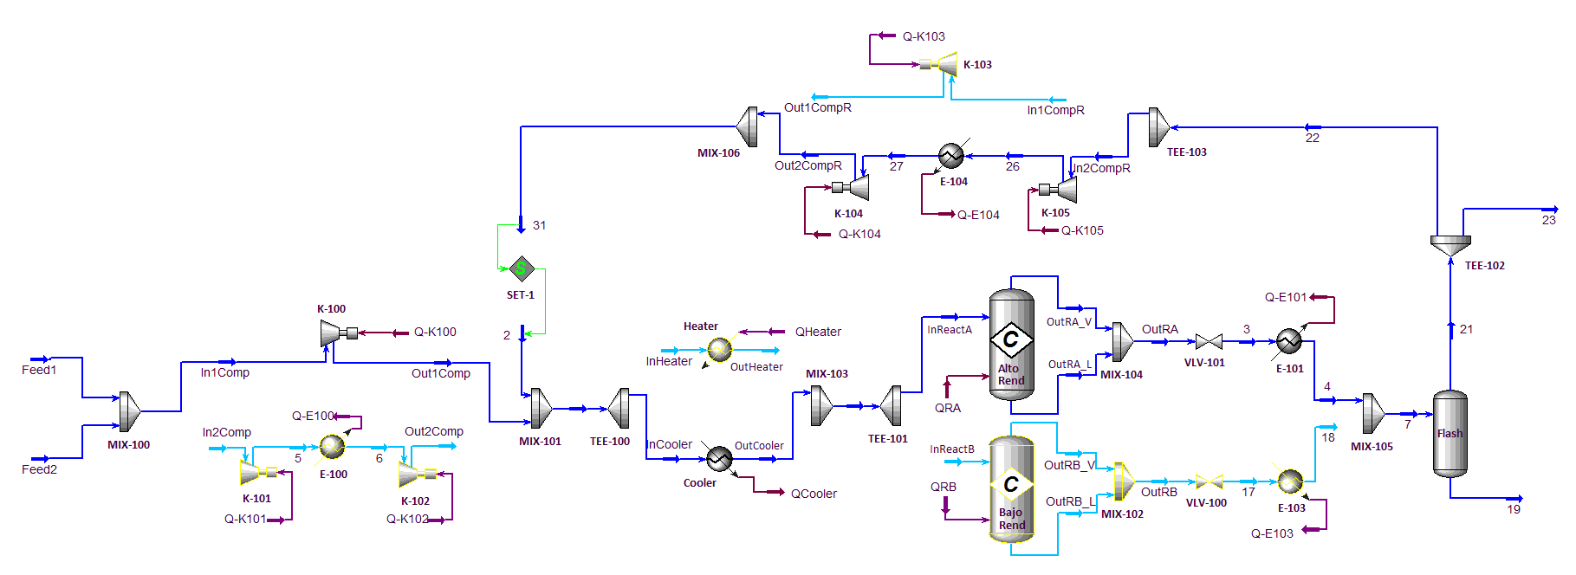
Example 3. Variable Topology (Logic Based Approach)
Synthesis of Methanol (Adapted from Kocis and Grossmann)
The recycle is converged by the optimizer not by the process simulator !!
Superstructure
Two different feeds
Low pressure
High pressure
Heater or cooler
Two different reacting conditions

Slide 22
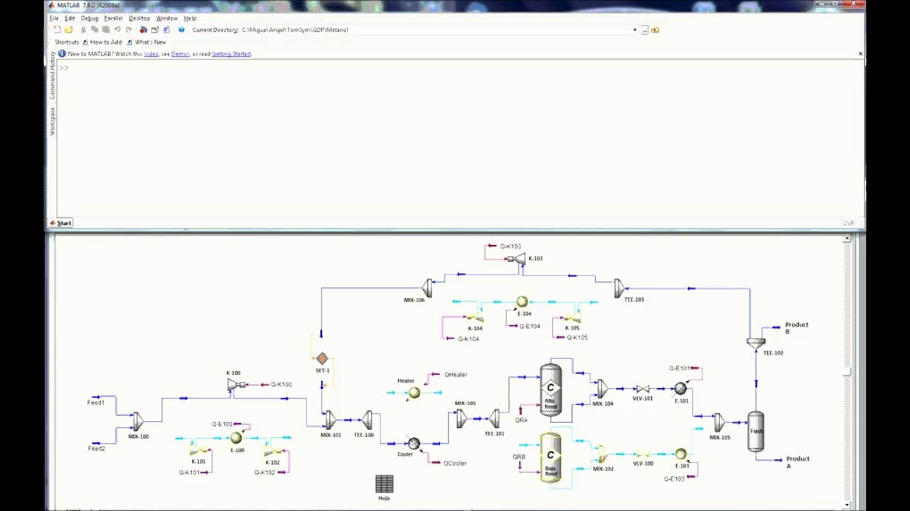

Slide 23
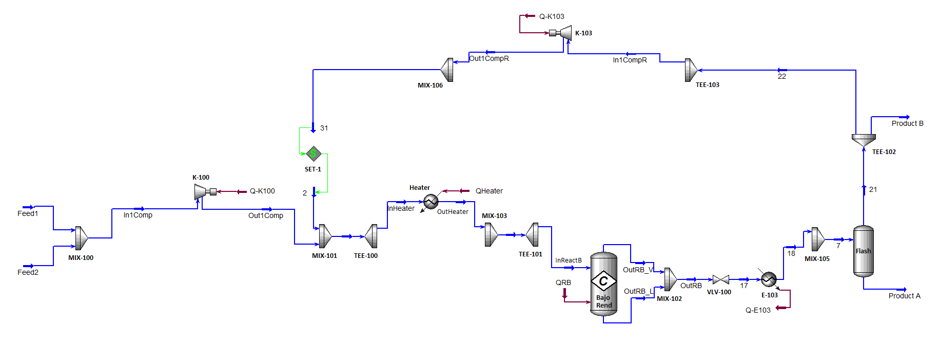
Optimal Solution
178 kW
31.2 atm
15876 kg/h
6410 kW
3353 kW
200 ºC
40 ºC
50 atm
402 m²
200 ºC
289 m²
5.754 10⁴ kg/h
Comp. mass frac.
H₂ = 0.1765
CO = 0.5733
CO₂ = 0.2502
32966 kW
41667 kg/h
MeOH > 90%
21249 kW
Variable Costs Investment
Feed: 9.307 M€ /year
Compressor k 100 1.111 M€/ year (electricity) 0.80 M€
Compressor k 103 0.031 M€/year (electricity) 0.0812 M€
Heater 0.194 M€/year (Steam) 0.158 M€
Reactor 0.167 M€/year (Refrg. Water) + 0.003 M€/year (cat) 0.0169 M€
Cooler E-103 0,107 M€/year (Refrg. Water) 0,139 M€

Slide 24
“Discrete variables that involve parameters in unit operations
require specially tailored algorithms”
EXAMPLE: OPTIMAL DESIGN OF A DISTILLATION COLUMN
Lang & Biegler (2002)
Discrete decisions (i.e. number of trays, feed tray location) are modeled by continuous variables . The authors place the continuous decision variables on bell-shaped curves with the help of a differentiable distribution function in order to locate optimal regions for the feed and the reflux/reboil streams.
Caballero & Grossmann (2005):
It uses the outer approximation algorithm. In each iteration (including the initialization) an NLP with fixed number of trays is solved. A heuristic MILP master is generated by linearizing the objective function and constraints and adding an extra term that is the effect of adding or deleting sets of distillation trays –obtained by simulations-.

Slide 25
“Discrete variables that involve parameters in unit operations
require specially tailored algorithms”…
… Or may be not !!
  1.- Column as a sequence of flash. (MINLP)
Condenser
Permanent
Main objective: increase the robustness by aggregating some equations, and taking advantage of the special numerical methods developed for solving these subset of equations.
The dimensionality of the optimization problem is reduced. The solver only ‘views’ the independent variables.
In MINLP zero flows are not a problem
Conditional Trays
Feed
Permanent
Feed
Conditional Trays
Reboiler
Permanent

Slide 26
Algorithm. (GDP model with MINLP reformulation).
Implicit equations solved by Simulis.Thermodynamics
Explicit equations viewed by the solver
(SNOPT-8)

Slide 27
Example 1: Water-Methanol-Acetone
NLP initial
20 trays. Feed tray 10
Objective = 2933 units;
CPU time = 430.3 s
Iteration 1. Master
Objective = 1422 units
CPU time =0.015 s
70 kmol/h
56.97 ºC
Q=1490 kW
MeOH… 0.5614
Acetone 0.4286
Water 0.01
Iteration 2. NLP
Objective = 2961.8 units
CPU time = 528.1 s
Iteration 2. Master
Objective = 2518
CPU time = 0.03 s
Methanol… 0.4
Acetone 0.3
Water … 0.3
4 trays
Iteration 3. NLP
Objective = 2474 units
CPU time = 329.7 s
Iteration 3. Master
Objective = 3045 units
CPU time = 0.05 s
5th Tray
100 kmol / h
P = 1 atm
3 trays
Total CPU time = 12881 s ~ 22 min
96.22 ºC
MeOH… 0.0233
Acetone 0.000
Water … 0.9767
Qreb= 1536 kW
Total CPU time

Slide 28
  2.- Selection of column sections.
Main Idea:
Decompose the distillation column in sections.
    In each section: select among a set of sections with different number of trays.
    The problem consists only in selecting the configuration (for each column section) with the number of trays that minimizes a performance function (i.e. TAC).

Slide 30
Hybrid Simulation-Optimization Algorithms.
  Selection of column sections.
However, the direct implementation of the previous idea, is not practical for systems with more than a single column:
  Very complex model in the process simulator (even more if we include two or more columns) that slows down the simulations.
  NLP optimization takes large CPU times –mainly due to the calculation of derivatives-

Slide 31
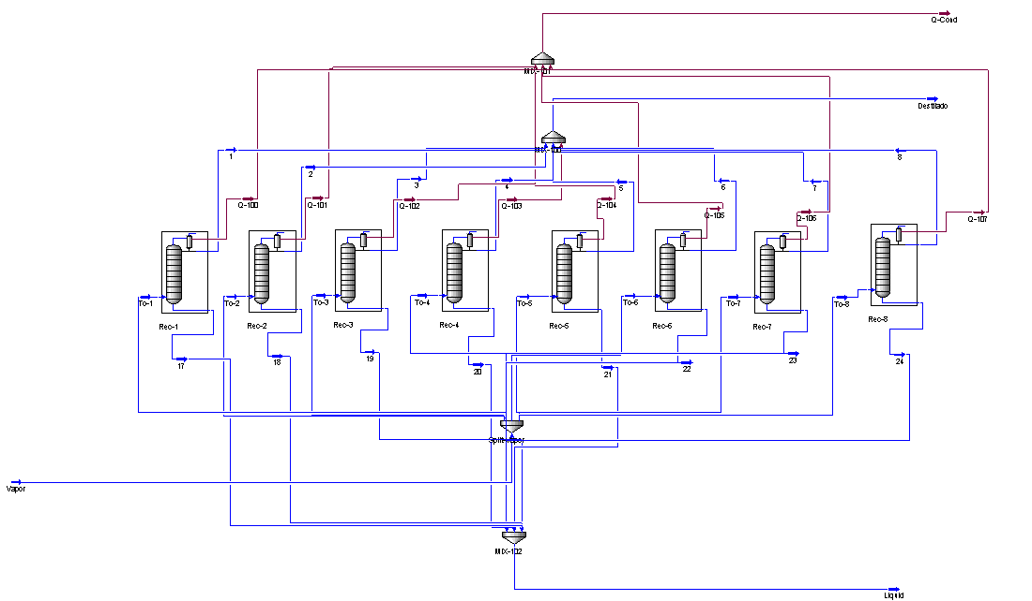
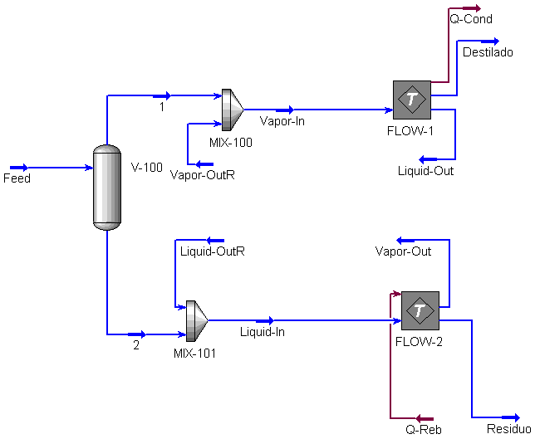
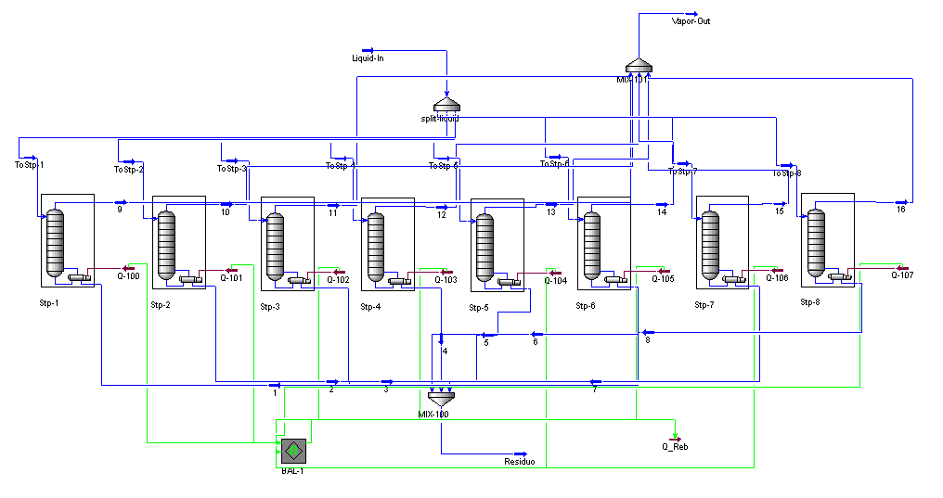

Slide 32
Hybrid Simulation-Optimization Algorithms.
  Selection of column sections.
Fortunately it is not necessary to use this ‘Brute Force Approach’
The model can be formulated as a Disjunctive Problem with Net Structure:
The Logic Based Outer Approximation algorithm (Turkay & Grossmann 1996) is perfect for solving this problem

Slide 33
Hybrid Simulation-Optimization Algorithms.
  Selection of column sections.
REMARKS:
  In the Logic-Based-OA algorithm, each NLP is formed by a potential flowsheet configuration, the rest of variables do not appear in the model. In this case a potential flowsheet is simply a distillation column.
  In a single column with fixed pressure there are only 2 degrees of freedom. Therefore the CPU time needed to solve each NLP is of a few seconds.
  Even in systems involving more than one distillation column these NLPs can be solved very efficiently. The same degree of difficulty that a regular NLP optimization in a process simulator.

Slide 34
Example 3: Ethanol, Propanol, Butanol
Initially :
  Total Number of Trays = 50;
  Feed in Tray 25
  5 fixed trays in each section
1283 kW
Ethanol (0.98 mf)
Strategy
Potential column sections in each ‘section’ that differentiate in 2 stages and contraction around the best solution.
Remarks:
The same solution was found using 5 potential sections that differentiate in 4 trays.
Tested with different starting combinations. All solutions found differs only in one tray.
12 trays
100 kmol/h
(0.3, 0.4, 0.3)
Feed 13th tray
D = 1.06 m
15 trays
1307 kW
TAC = $ 433.4 10³ /year

Slide 35
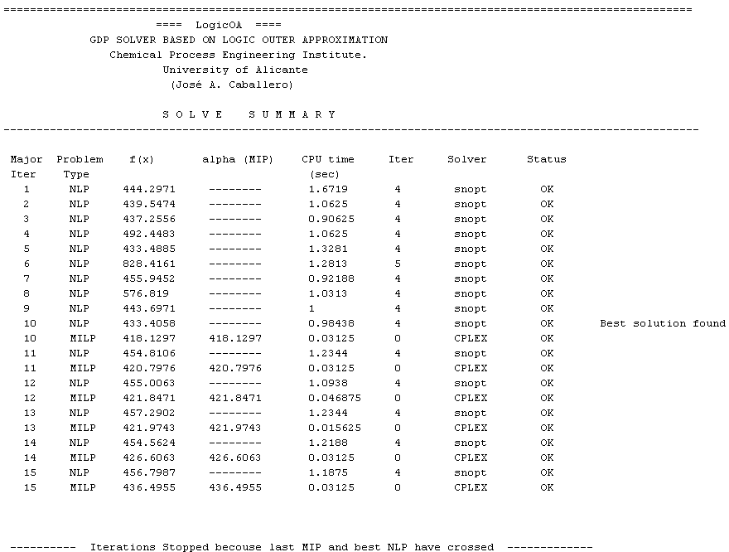
Results of the last Major iteration.
Total CPU time ~ 15 s.

Slide 36
Example 4
Benzene
( > 0.99 m.f.)
3
4
5
Isomolar mixture of:
Benzene, Toluene, p-Xylene, Bi-Phenilo.
Number of Trays and position of feeds and products in the column sequence of the Figure.
Objective:
Minimize Total Annualized Cost.
Toluene
( > 0.99 m.f.)
1
2
6
8
200 kmol/h
(isomolar)
7
p-Xylene
( > 0.99 m.f.)
Bi-Ph
( > 0.99 m.f.)

Slide 37
2306 kW
Example 4: Optimal solution
Benzene
( > 0.99 m.f.)
3
4
D = 1.87 m
~ 3 min. CPU TIME
200.6 kmol/h
14th Tray
31 Trays
119.2 kmol/h
D = 0.89 m
200 kmol/h
(isomolar)
1
2
D = 1.69 m
Toluene
( > 0.99 m.f.)
27 Trays
Feed 15th Tray
5
6
D = 1.74 m
D = 0.89 m
183.8 kmol/h
15th Tray
556.2 kW
34 Trays
302.4 kmol/h
7
8
p-Xylene
( > 0.99 m.f.)
D = 2.0 m
D = 0.89 m
226.5 kmol/h
5th Tray
13 Trays
326.4 kmol/h
D = 2.44 m
Bi-Ph
( > 0.99 m.f.)
3791 kW

Slide 38
Unfortunately not everything is so beautiful…
In modular process simulators:
No derivative information available
Perturbation does not always provide accurate derivatives due to the noise introduced by the model
Qcond
Example
Minimize the heat load in a distillation column
Free variables Reflux and Reboil Ratio
Process Simulator HYSYS
100 kmol/h
28 theoretical trays.
Feed tray = 14
Isomolar mixture
n-C4 i-C4,
n-C5, i-C5
Pressure fixed = 450 kPa
Qreb

Slide 39
Optimization using state of the art NLP solvers:
CONOPT (Drud, 1996); SNOPT (Gill et al, 2002); KNITRO (waltz & Plantenga, 2007)
Available in TOMLAB-MATLAB and connected to HYSYS.Plant through Windows COM.
1.- Derivatives calculated by perturbation and default parameters
All the solvers fail to obtain a solution
2.- Perturbation parameter increased to 10⁻³
SNOPT find a solution
KNITRO and CONOTP erratic behavior: sometimes stopped prematurely in an infeasible solution and others provide a solution.
3.- Perturbation parameter increased to 5·10⁻³
All solvers find the optimal solutions (although some times stopped in an infeasible solution)
Tightening the HYSYS tolerances to (mass and energy balances to 10⁻⁶) it is possible to get consistent solutions with perturbations of 5 10⁻⁴

Slide 40
What is the reason of that behavior ?
Noise introduced in the calculation of derivatives
Consider the following numerical experiment
Converge the flowsheet using the optimal values of RR and RB and read heat load in reboiler
Randomly select new values for RR and RB and converge the column again.
Repeat step 1. The heat load should be the same that in step 1, but…
Mean value = 1556.4 kW; standard deviation = 0.49

Slide 41
A good approach to solve those problems may be to use the original model as a source of ‘computational experiments’ that produce data points in the same way as if we had performed a physical experiment. With these data we can use a simpler model that involves explicit functions. These new models are referred as surrogate, reduced order or metamodels
Kriging Metamodel (G.G. Krige, 1951 )

Slide 42
Kriging Interpolation:
Kriging assumes that errors are not independent but a function of x
Usually f(x) = μ
= Process Variance
Spatial correlation function : No Euclidean
Include adjustable parameters
Due to these parameters it is not sensitive to the units of measurements
The final predictor for the new point (x^{new}, y^{new})
Standard error predicted by the interpolator
(a non interpolation version is easy to implement as well)

Slide 43
Kriging Example
Actual function
Kriging interpolation based on the 33 points in figure

Slide 44
Kriging Example
Actual function
Kriging interpolation
Errors predicted by the kriging

Slide 45
Analytical
Calculated by kriging

Slide 46
The kriging metamodels can be used as implicit models or can be explicitly included (explicit equations) in a model.
Using explicit kriging we can formulate the problem of synthesizing a distillation column as an optimization problem that can be solved to global optimality (i.e. GAMS/BARON).

Slide 47
Thank you for your attention
E-mail: caballer@ua.es

