Slide 1
Towards a Fast Heuristic for MINLP
John W. Chinneck, M. Shafique
Systems and Computer Engineering
Carleton University, Ottawa, Canada

Slide 2
Introduction
Goal: Find a good quality integer-feasible MINLP solution quickly.
Trade off accuracy for speed
No guarantee of finding optimum
Target: very large MINLP instances
Method: use a fast approximate Global Optimizer within a B&B framework

Slide 3
The Fast Global Optimizer
Why is nonconvex GO hard?
Multiple disconnected feasible regions
Multiple local optima
Many places to look for optima
Two main categories of methods:
Space-covering global optimizers:
Accurate, but slow: inherent tree search
Multi-start local optimizers:
Faster, but not as accurate: whole space not searched
Goal: fast and reasonably accurate GO
Trade a little accuracy for speed

Slide 4
GO Components
Main idea:
Multi-start based (for speed)
Better exploration of the variable space before launching the local solver (for accuracy)
Our main contribution
Main steps:
Goal: find local solver launch points that lead to global optima
Latin Hypercube sampling in a defined launch box
Constraint Consensus concentration
Clustering
Simple Search
Local solver launches

Slide 5
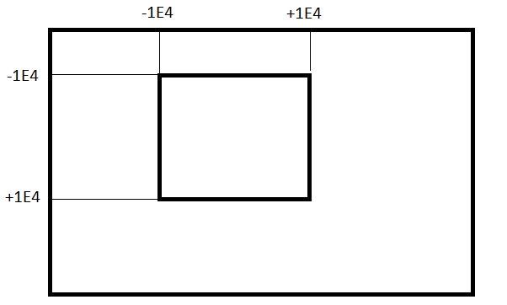
1. LHC Sampling in the Launch Box
LB₁
UB₁
UB₂
LB₂
Initial launch box based on empirical results:
Most NLP solutions are in this range
Shifted appropriately according to the bounds

Slide 6
2. Constraint Consensus (CC)
Projection method: iteratively adjusts point to reduce constraint violation(s).
Quickly moves initial point to near-feasible final point.
Very fast: no matrix inversion, no line search
Reduces local solver time, improves success
Compute Feasibility Vectors
Compute Consensus Vector
Current Point
Update Location

Slide 7
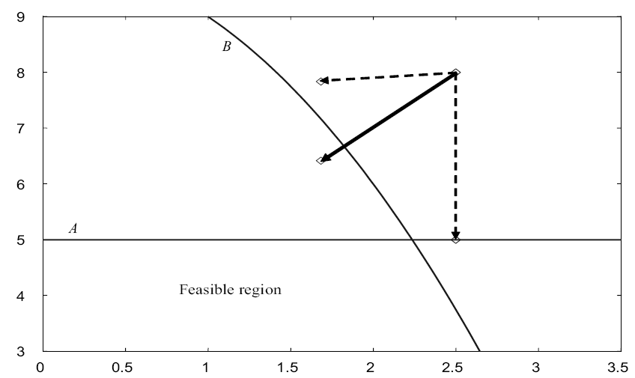
Constraint Consensus
***add illustration of CC move
CC start point
After 1 iteration

Slide 8
3. Clustering of CC end points (CB)
Single linkage clustering: pts closer than critical distance assigned to same cluster
Critical distance: based on distribution of inter-point distances
Small distances: points in same cluster
Large distances: points in different clusters
Choose critical distance based on this
Effect: clusters correlate with feasible regions

Slide 9
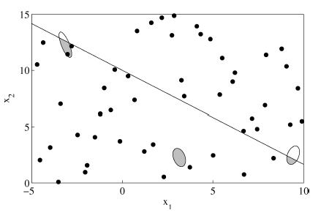
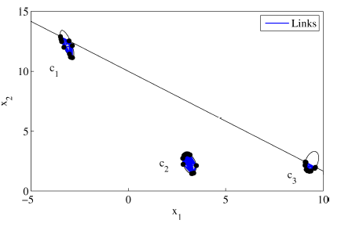
LHC
Final clusters
CC end pts
Inter- point distances

Slide 10
4. Simple Search (SS)
Derivative-free neighborhood search for better points in a cluster
considers both feasibility and objective function
Point quality metric (minimization):
Penalty function: P(x) = f(x) + (maximum violation)²
x
Interior random search
Exterior random search
Replace worst point
Continue until no improvement for several iterations
x

Slide 11
Complete GO Algorithm
LHC
Serial
Serial, but parallelizable. 2 - 4 rounds.
CC
Parallel
CB
Serial
SS
Parallel
Select launch pts
Serial. Identify x having best P(x) value. Note it’s round. Take best point in each of 3 best clusters in that round.
Local solver
Parallel
Result

Slide 12
Experimental Setup: Software
Test set: CUTeR ^{[3]} models having at least one non-linear function (constraint or objective)
Small (<300 constraints): 751 models
Medium (300-999 constraints): 29 models
Large (1000+ constraints): 99 models
Software: OS: Fedora 17, 64 bit. Compiler: GCC 4.7.2
Local solver: IPOPT 3.11.1, linear solver MA86 serial mode, default settings
Parameter settings:
Time limit: 500 seconds
Feasibility tolerance: 1×10⁻⁶ throughout
LHC parameters: 40 points, launch box edge length 2×10⁴
CC parameters: 100 iterations per CC run, time limit: 1 sec/run
SS parameters: At least 10 points per cluster, continue improving until three successive failures.
2 rounds

Slide 13
Experiment 1: Hardware
For BARON, Couenne, SCIP, LINDO:
2.66 Ghz 64-bit Intel Xeon X5650
All results from Nick Sahinidis, March 2013
For our method:
3.4 GHz 64-bit Intel i7-2600, 16 GB RAM
4 cores, so 4 simultaneous threads
But 3 parallel local solver launches (3 points kept)
Times adjusted by CPU benchmarks

Slide 14
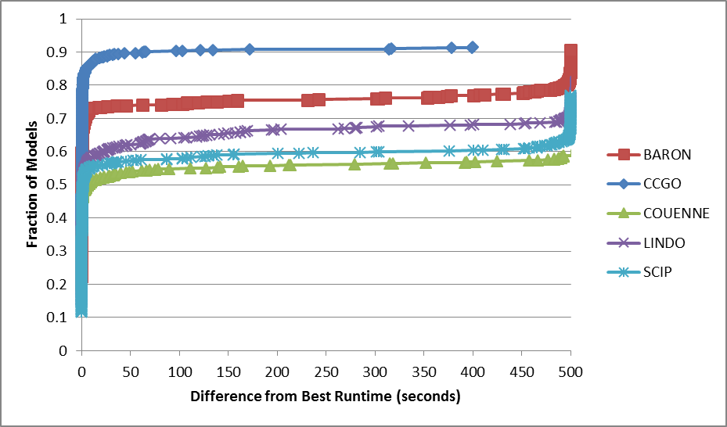
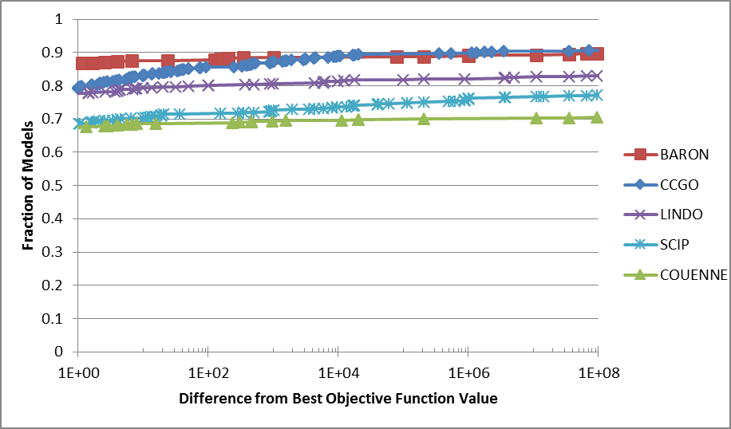
Small Models
Log scale solution quality
Linear scale solution time
Scaled by CPU benchmarks

Slide 15
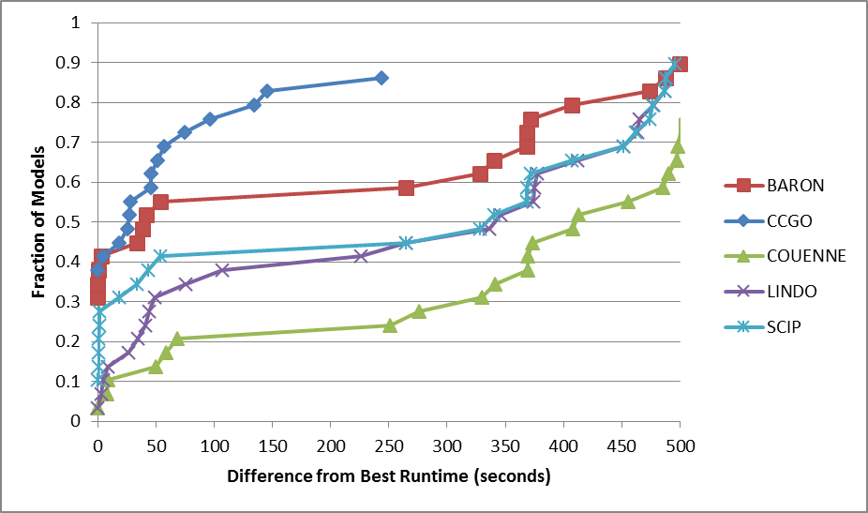
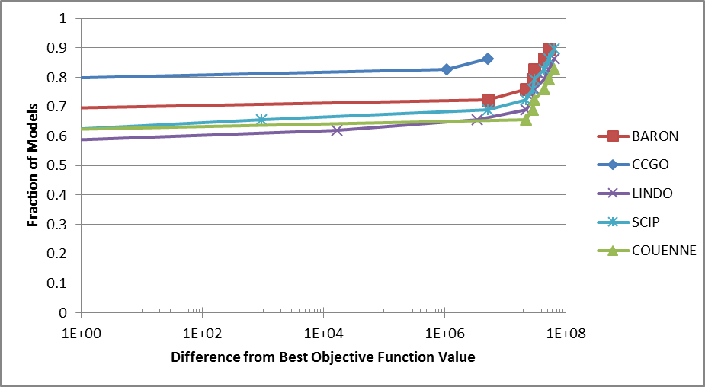
Medium Models

Slide 16
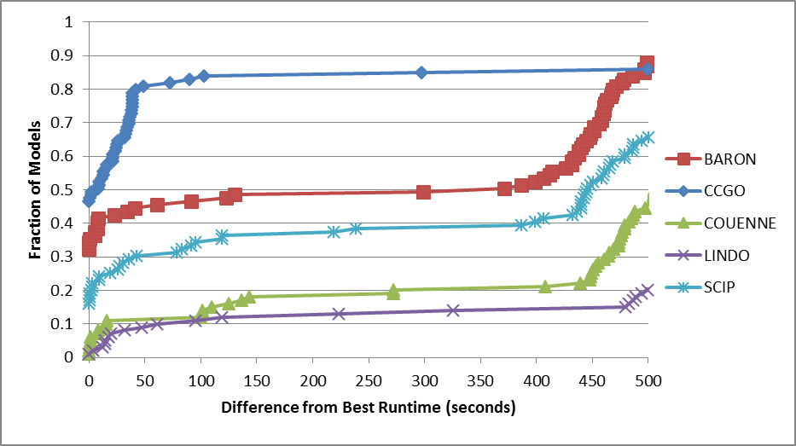
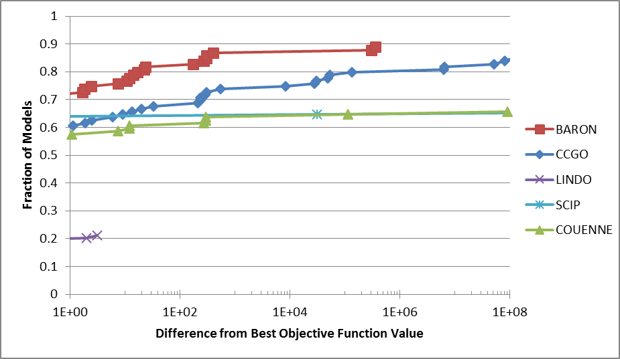
Large Models

Slide 17
Success Rate
Problem Category | Solver Returns a Solution for % of Models
 | CCGO | BARON | COUENNE | LINDO | SCIP
Small | 91.48 | 90.55 | 71.90 | 84.02 | 78.56
Medium | 86.21 | 93.10 | 82.76 | 82.76 | 86.21
Large | 85.86 | 88.89 | 66.67 | 21.21 | 66.67

Slide 18
Experiment 2
All solvers on same hardware:
3.4 GHz 64-bit Intel i7-2600, 16 GB RAM
4 cores, so 4 simultaneous threads
But 3 parallel local solver launches (3 points kept)
Best feasible or optimal soln within 500 sec
Vs. AMPL-linked free solvers:
SCIP 3.1.0
Couenne 0.3.2
Waiting for AMPL-BARON

Slide 19
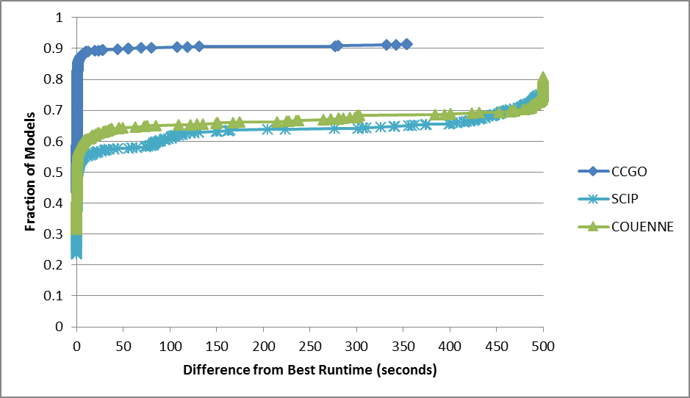
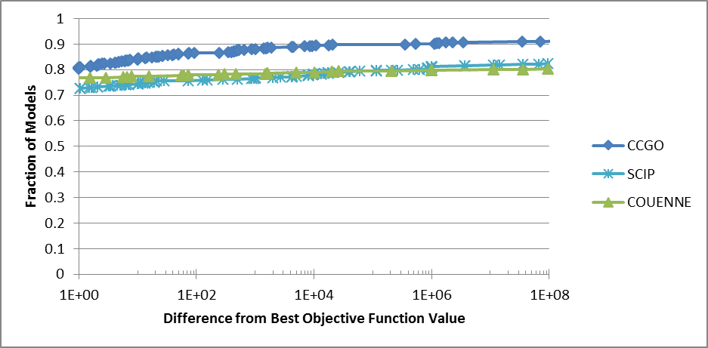
Small Models

Slide 20
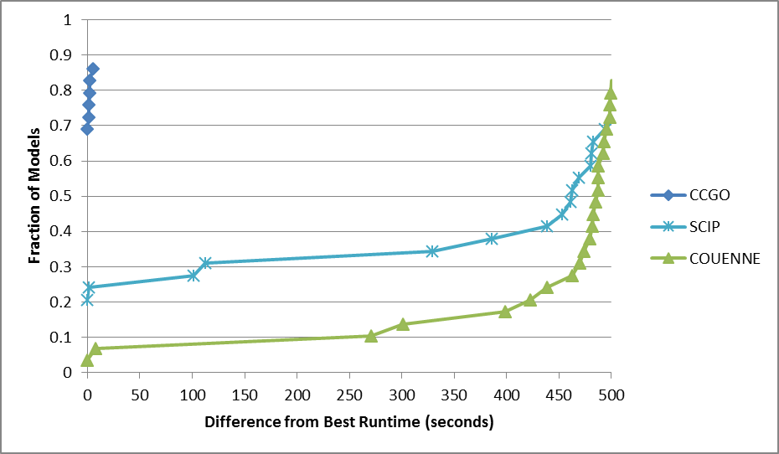
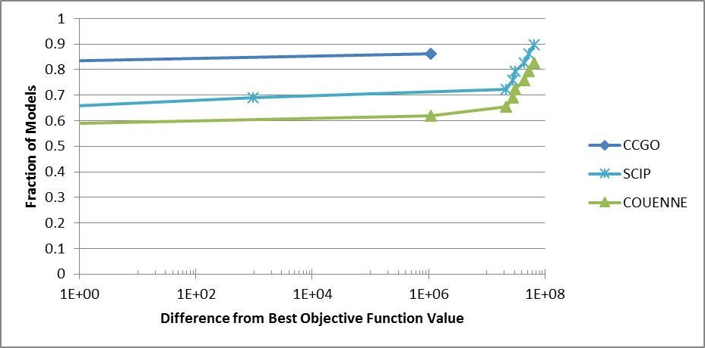
Medium Models

Slide 21
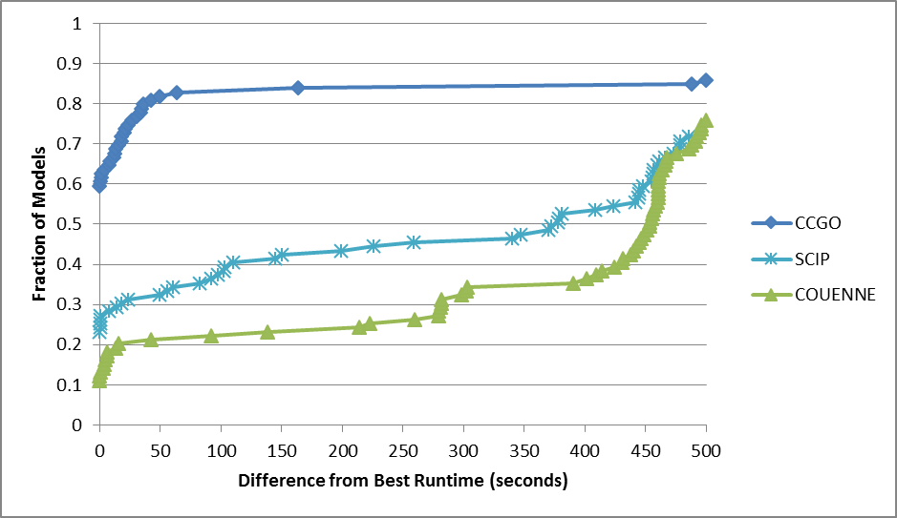
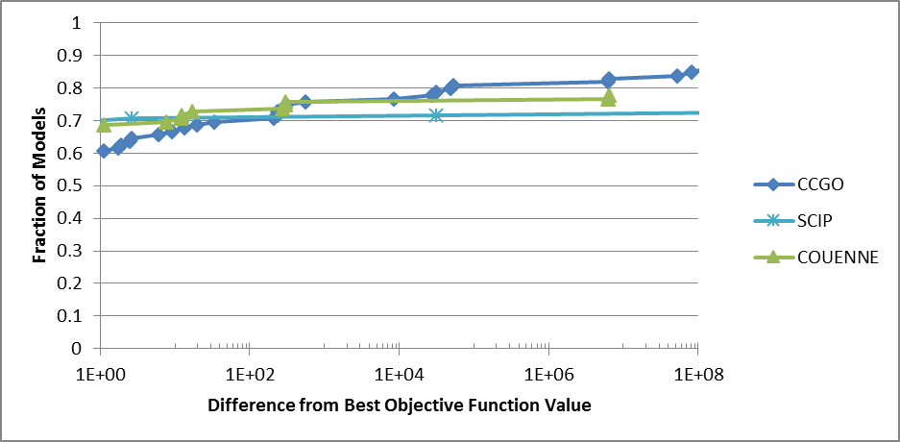
Large Models

Slide 22
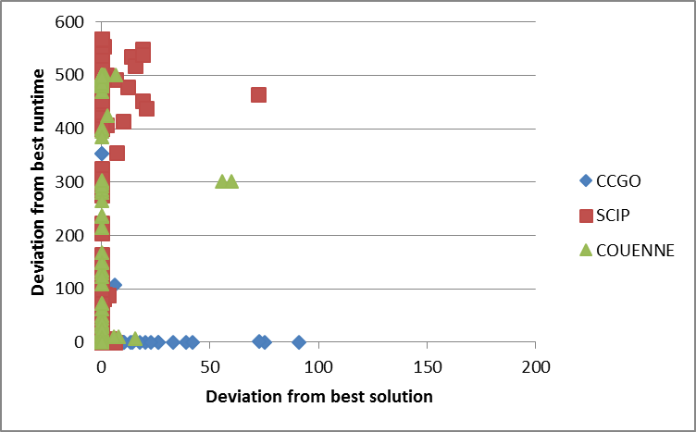
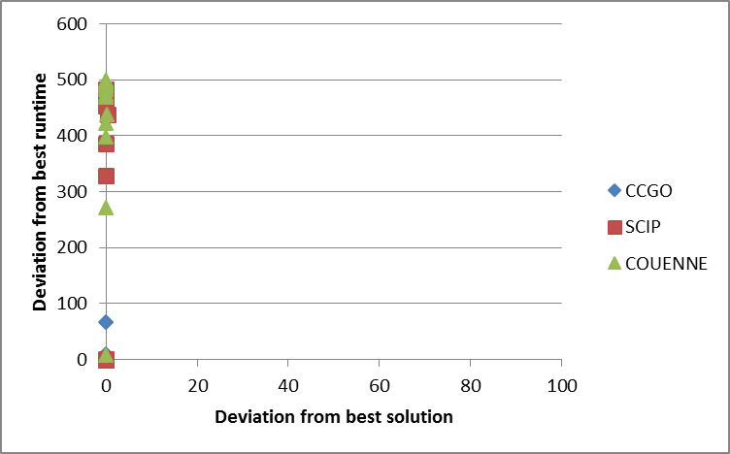
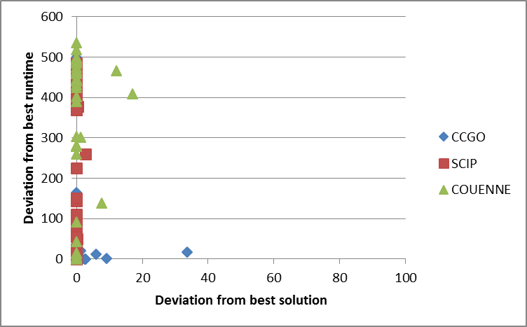
Small Models
Medium Models
Large Models

Slide 23
Towards MINLP
Goal: few local solver launches
Main ideas:
Solve GO problem approximately
LHC-CC-CB-SS, but no local solver launch
B&B on integer variables at approximate GO solution
When all integer variables fixed at integer values, launch local solver

Slide 24
Approx GO soln for all new nodes
Start
Y
Integer feasible?
Fix integer variables and launch local solver
N
Add node to list (unless pruned)
Update incumbent?
Node list empty?
Remove node from list
N
Y
Select node based on P(x)
Exit
Create child nodes by branching on integer variable

Slide 25
Branching Issues
Approximate solution affects branching
MILP:
Exact solver
Branching tends to increase integrality
MINLP with approximate GO solution:
Branching may not force early integrality
May have to branch until upper bound = lower bound

Slide 26
Branching Issues (contd)
Round to integrality within a (larger) tolerance (e.g. 0.1)?
Seed the initial random sample of the new subspace with a rounded solution.
Parent solution (11.6, 12.2, 9.5)
Down branch special point (11.6, 12.2, 9.0)
Up branch special point (11.6, 12.2, 10.0)
Take action if too many open nodes
E.g. round integer variables and launch local solver to get a better incumbent

Slide 27
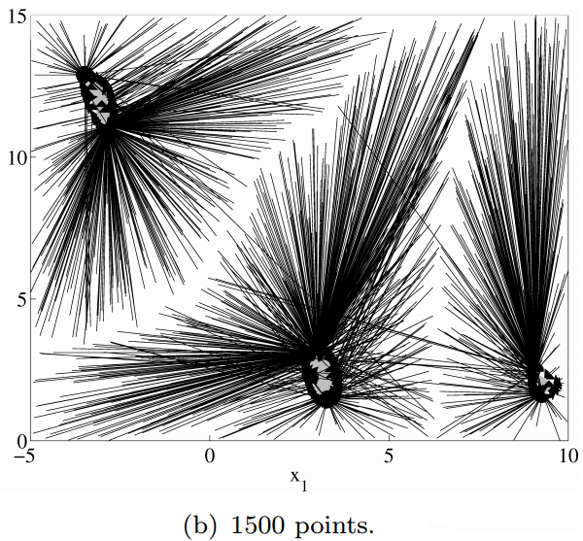
Spatial Branching
Likely not needed
If needed: CC start-end pairs map basins of attraction for feasible regions
Subdivide using CC start-end pairs to define basins of attraction

Slide 28
Conclusions
GO results are promising!
Good quality solutions
Solutions usually faster
Future MINLP work:
Algorithm optimization
Tuning all GO parameters.
Better simple search?
Best number of parallel threads
Where to use them? More threads per node? Solve multiple nodes simultaneously? Parallel rounds?
Rounding heuristics
Proper comparison to other MINLP solvers

Slide 29
Looking for Postdoc or PhD Student
MINLP and other optimization topics
Algorithm development and testing
Good programming skills
Helpful to know:
Parallel programming
C, C++, Go, Julia
Should like winter

Slide 30
References
J.W. Chinneck (2004)."The Constraint Consensus Method for Finding Approximately Feasible Points in Nonlinear Programs", INFORMS Journal on Computing16,(3)255-265.
W. Ibrahim, J.W. Chinneck (2008). Improving Solver Success in Reaching Feasibility for Sets of Nonlinear Constraints, Computers and Operations Research 35(5)1394-1411.
L. Smith, J.W. Chinneck, V. Aitken (2013). “Constraint Consensus Concentration for Identifying Disjoint Feasible Regions in Nonlinear Programs”, Optimization Methods and Software 28(2)339–363.
http://www.cuter.rl.ac.uk/Problems/mastsif.shtml
A. Waechter, L.T. Biegler (2006).“On the Implementation of a Primal-Dual Interior Point Filter Line Search Algorithm for Large-Scale Nonlinear Programming”, Mathematical Programming 106:25-57.

