Slide 1
A hybrid CONSTRAINT PROGRAMMING-Optimization based infeasibility diagnosis framework for nonconvex NLPs and MINLPs
Yash Puranik
Advisor: Nick Sahinidis
The authors would like to thank Air Liquide for providing partial financial support and motivation for this work

Slide 2
MODEL SUBMISSION STATISTICS via NEOS SERVER for BARON
7% of 18095 problems submitted were infeasible
2

Slide 3
IIS ISOLATION
Identification of Irreducible Inconsistent Sets (IIS) (van Loon, 1980) can help speed up the diagnosis process
IIS is an infeasible set with any proper subset feasible
IIS provides a set of inconsistencies that must be eliminated from the model
b
c
a
Infeasible
3

Slide 4
IIS ISOLATION
Identification of Irreducible Inconsistent Sets (IIS) (van Loon, 1980) can help speed up the diagnosis process
IIS is an infeasible set with any proper subset feasible
IIS provides a set of inconsistencies that must be eliminated from the model
b
✓
✓
✓
c
a
Infeasible
a
b
c
4

Slide 5
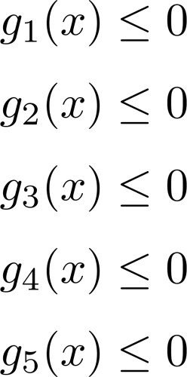
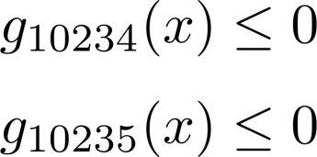
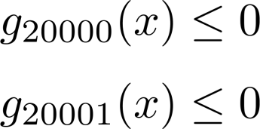
ISOLATING INFEASIBILITY
IIS
5

Slide 6
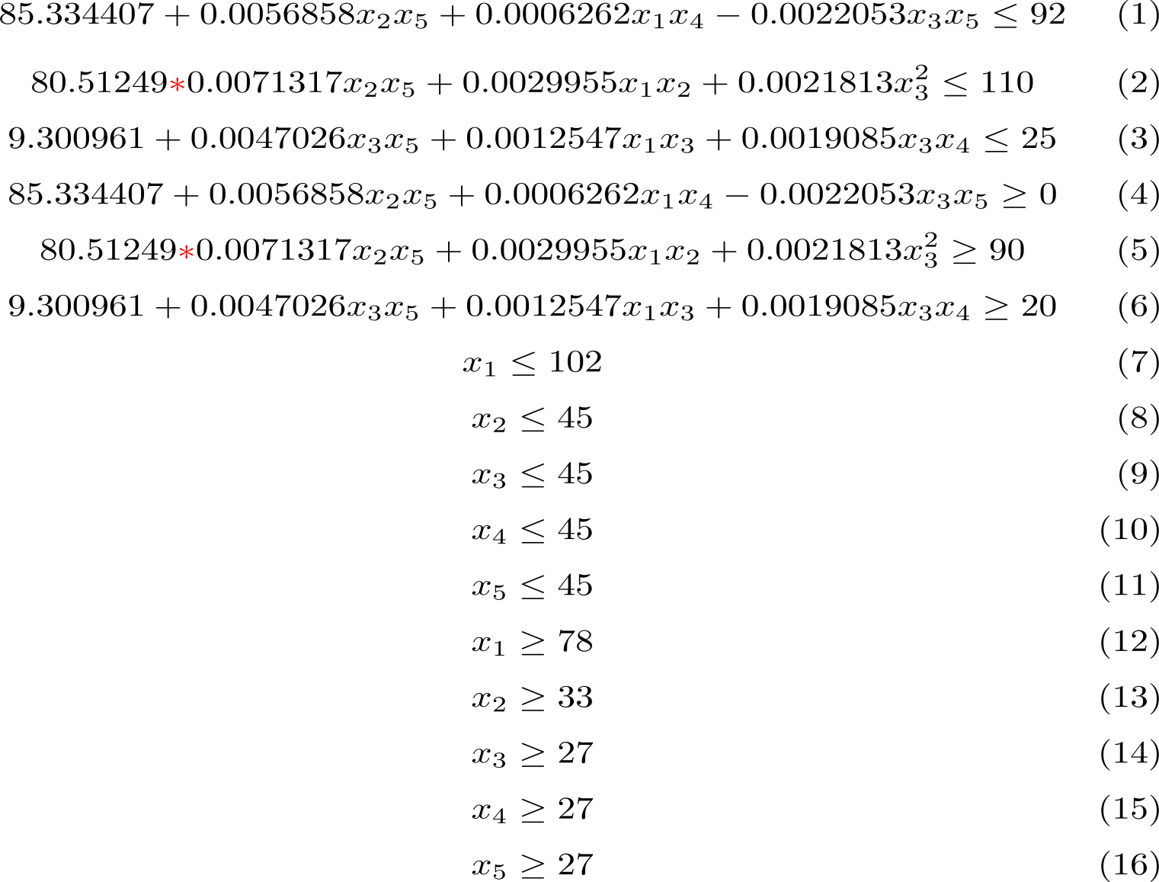
EXAMPLE (Himmelblau, 1972; Chinneck, 1995)
6

Slide 7
INFEASIBILITY DIAGNOSIS FOR LPs
Irreducible Infeasible Sets (IIS) for linear programs (Chinneck and Dravnieks 1991, Chinneck 1996)
Deletion filter
Delete one constraint from candidate set and test for feasibility
If infeasible, eliminate constraint permanently
If feasible, retain the constraint
Loops through all the constraints exactly once
On completion, obtains exactly one IIS
7

Slide 8
MODEL STATUS: INFEASIBLE
8

Slide 9
9

Slide 10
MODEL STATUS: FEASIBLE
10

Slide 11
11

Slide 12
MODEL STATUS: INFEASIBLE
12

Slide 13
IIS OBTAINED
13

Slide 14
RELATED WORK
Multiple filtering algorithms proposed: algorithms rely on solving several feasibility problems
The feasibility subproblems either eliminate constraints not part of an IIS or identify members of an IIS
Some of the proposed algorithms include:
Elastic filter (Chinneck and Dravnieks, 1991)
Addition filter (Tamiz et al., 1994)
Adddition-deletion filter, dynamic reordering additive method (Guieu and Chinneck, 1999)
Depth first binary search filter, generalized binary search filter (Atlihan and Schrage, 2008)
14

Slide 15
CHALLENGES FOR NLPs
Methods established for linear programs are part of commercial codes CPLEX (1993), XPRESS (1997)
Similar framework for nonlinear programs (Chinneck 1995). However, the following challenges exist:
choice of initial point
“hot start” for NLPs is more challenging
Global search necessary for nonconvex NLPs to prove infeasibility by exhaustively searching the domain
15

Slide 16
MOTIVATION FOR Proposed APPROACH FOR MINLPs
Experience with industrial model suggested basic causes of infeasibilities
Transcription errors
Incorrect bounds
Inferred bounds from constraints in conflict with specified bounds
Presolve techniques can efficiently identify conflicting bounds
Proposed methodology
Use presolve techniques to identify a candidate set of constraints
Apply filtering algorithm on this test set to identify IIS
16

Slide 17
PRESOLVE: FEASIBILITY-BASED DOMAIN REDUCTION
Brearley et al. (1975), Fourer and Gay (1994), Sahinidis (2003), …
Crossing of bounds implies infeasible model
A quick and computationally inexpensive test of infeasibility
17

Slide 18
PROPOSED INFEASIBILITY DIAGNOSIS FRAMEWORK
Preprocessing: Identify a reduced test set of constraints
Drop one constraint and presolve the model
If model proved infeasible, drop the constraint permanently
Loop through all constraints to identify a candidate set of constraints
Filtering: Filter this reduced candidate set to obtain IIS
BARON is ideal for filtering
Implements presolve techniques
Capability to terminate with first feasible solution
Exhaustive search of domain through branch and bound – rigorous proof of infeasibility
18

Slide 19
ILLUSTRATIVE EXAMPLE–Revisited
19

Slide 20
PRESOLVE STATUS: INFEASIBLE
20

Slide 21
REDUCED SET
21

Slide 22
BENEFITS OF THE FRAMEWORK
Leverage presolve to potentially eliminate large number of problem constraints
Presolve is computationally inexpensive. This elimination can be achieved rapidly
Filtering will have to solve fewer feasibility problems for IIS isolation
Preprocessing stage may be sufficient to isolate the IIS for many problems
22

Slide 23
COMPUTATIONAL EXPERIMENTS
A test set of 983 infeasible problems submitted to BARON via NEOS server
Implemented proposed framework with following algorithms:
Deletion filter
Addition filter
Addition-deletion filter
Depth first binary search filter
Results presented here compare deletion filtering with preprocessing v/s pure deletion filtering
Model type | Number of problems
LP | 24
MIP | 115
NLP | 235
MINLP | 609
23

Slide 24
SELECTED Computational times
Model Name | Time to return infeasibility [s] | Time to find an IIS with deletion filtering [s]
inf_mip_71 | 0.8 | >500
Inf_mip_18 | 0.8 | >500
Inf_nlp_29 | 0.65 | >500
Inf_nlp_186 | 5.51 | >500
inf_minlp_6 | 0.68 | >500
Inf_minlp_220 | 0.1 | >500
inf_rminlp_14 | 0.68 | 106
inf_mip_104 | 0.66 | >500
inf_minlp_562 | 1.94 | 212
Deletion filter on an average takes 325 times more time
24

Slide 25
AVERAGE COMPUTATIONAL TIMES
25

Slide 26
SELECTED IIS CARDINALITIES
Model | Original model size (rows + columns) | IIS size (rows + columns)
inf_mip_71 | 13322 | 1*
Inf_mip_18 | 13322 | 1*
Inf_nlp_29 | 10174 | 28
Inf_nlp_186 | 30327 | 70
inf_minlp_6 | 10874 | 3
inf_minlp_220 | 2768 | 4
inf_rminlp_14 | 11750 | 4
inf_mip_104 | 13322 | 1*
inf_minlp_562 | 782 | 7
*Binaries were enforced for MIPs and MINLPs for IIS isolation
26

Slide 27
IIS CARDINALITIES (%)
IIS contains 10% of original rows and 20% of original columns on average.
For over 272 models, less than 1% of model rows and columns in an IIS
27

Slide 28
PREPROCESSING IMPACT ON SOME PROBLEMS
Model | Original model size (rows + columns) | Reduced model after preprocessing (rows + columns) | IIS size (rows + columns)
inf_mip_71 | 13322 | 2447 | 1*
Inf_mip_18 | 13322 | 378 | 1*
Inf_nlp_29 | 10174 | 28 | 28
Inf_nlp_186 | 30327 | 70 | 70
inf_minlp_6 | 10874 | 6 | 3
Inf_minlp_220 | 2768 | 14 | 4
inf_rminlp_14 | 11750 | 8 | 4
inf_mip_104 | 13322 | 378 | 1*
inf_minlp_562 | 782 | 7 | 7
*Binaries were enforced for MIPs and MINLPs for IIS isolation
28

Slide 29
PREPROCESSING EFFICIENCY
Preprocessing eliminates 68% rows and 72% columns not in IIS on average
For 284 problems, preprocessing reduces the model to an IIS
29

Slide 30
SPEEDUPS DUE TO PREPROCESSING
Model | Deletion filter [s] | Deletion filter with preprocessing [s]
inf_mip_71 | >500 | 24
Inf_mip_18 | >500 | 27
Inf_nlp_29 | >500 | 8
inf_nlp_186 | >500 | 145
inf_minlp_6 | >500 | 2
inf_minlp_220 | >500 | 62
inf_rminlp_14 | 106 | 0.76
inf_mip_104 | >500 | 26
Inf_minlp_562 | 212 | 0.27
Deletion filter is 13 times faster on average with preprocessing
30

Slide 31
CONCLUSIONS
Proposed an IIS identification approach for nonconvex NLPs and MINLPs
On our test set, finding an IIS takes about 25 times the CPU time to prove infeasibility
Preprocessing speeds up deletion filtering by 13 times on average
Preprocessing reduces the problem to an IIS for most problems in our test set
Infeasibility library will be made available at http://archimedes.cheme.cmu.edu
31

